Slide 1
Run Bevo Run
GROUP 11 || iOS Mobile Computing Presents:
Jacqueline Corona
Rachel Andrews
Patrizio Chiquini
Notes:
CS 378 - iOS Mobile Computing Date: Project Presentation Evaluation (do not write your name)
Presentation 1 Name (P1):
Presentation 2 Name (P2):
Presentation 3 Name (P3):
Presentation 4 Name (P4):
Presentation 5 Name (P5):
Presentation 6 Name (P6):
On a scale of 1 - 5 (5 being best), rate the following aspects of each presentation:
1. Interest: How interesting is the application.
2. Flow: The application ﬂow was done well. It had a logical, intuitive ﬂow.
3. Delivery: The quality of the delivery of the presentation - e.g. spoke clearly, etc.
4. Overall: Your overall impression of the application.
Additional comments: (identify which presentation a comment relates to)

Slide 2

Interest: So why the application?
Target Audience:
- New outlet for information
- Focus points about UT
- Digital Interaction
Showcase:
- UT Austin history
- Increase knowledge
- Start UT conversation
Relationships:
- Break the ice
- Create friendships
- Release stress

Slide 3
Contributions
Patrizio Chiquini:
* Bevo Animations and some UI
* SpriteKit Scenes Editor/Transitions
* Altering Each Scenes Difficulty (managing items/platforms/enemies)
* Proper Calculation of the Point System
Rachel Andrews:
* Login Screen
* Registration Scene
* Trivia Question Screen
* Creating Database of Questions
* Implementing UserInfo() to keep track of points per game play
Jacqueline Corona:
* UI Implementation (4 level scenes and 4 enemies)
* Keeping Consistency Between Scenes
* Making and keeping the application’s image consistancy

Slide 4

Challenges
- SpriteKit API
- Transitions between Storyboards and Scenes
- Level Difficulties
- Keeping Track

Slide 5
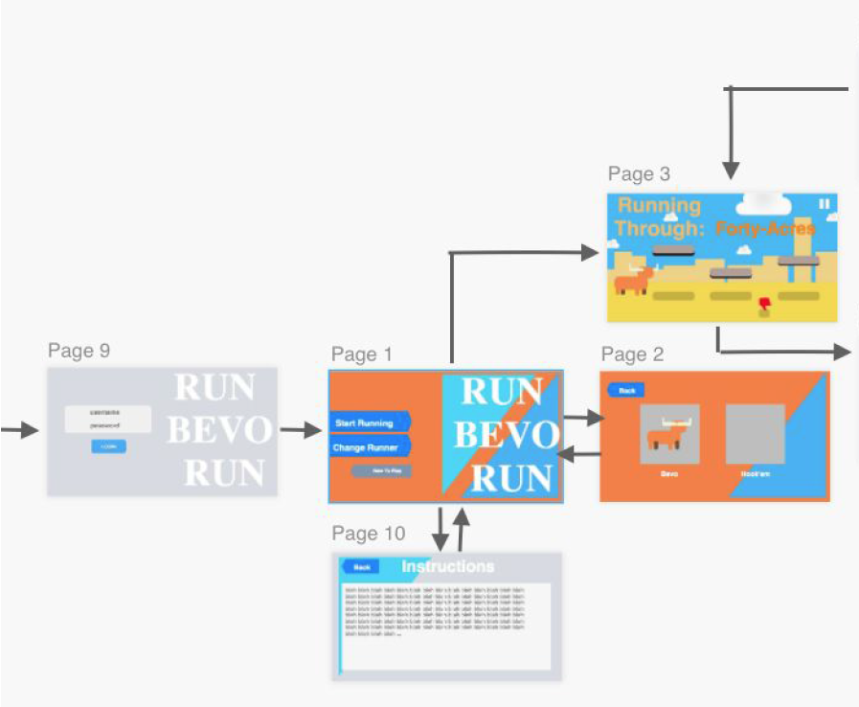
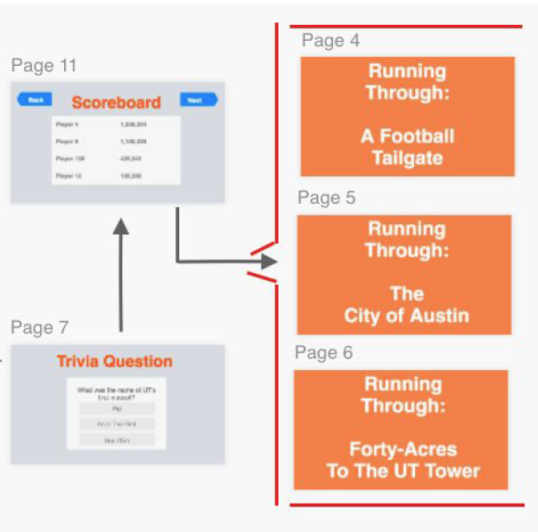
Functionalities:

Slide 6
UT Campus
Downtown Austin
DKR Football Game
UT Campus (Graduation)

Slide 7
Demo

Slide 8
The Last Release
Additional Features:
- Character Options
- Main Menu Music
- More Sound Effects
- Competitive Leaderboard
MORE FUN!

Slide 9

What Is Next?
Addition to the Orientation:
- Provide additional information
- Encourage student interactions
- Enable students to get into UT mindset
- Have MORE fun at orientation

Slide 10
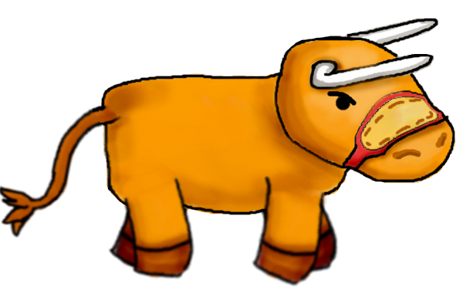

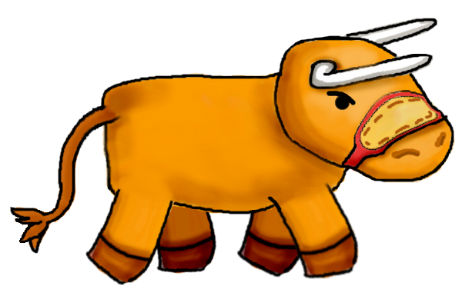
Thank You

